Slide 1
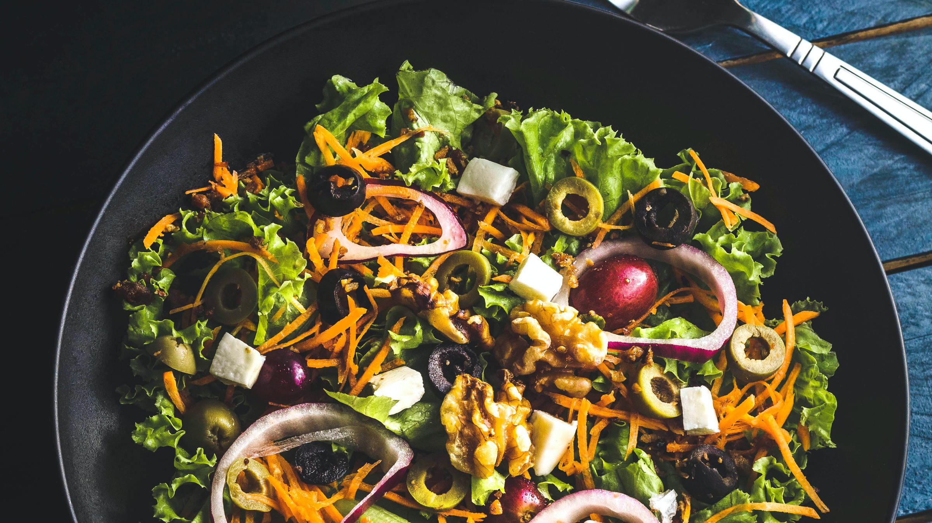

Teamsavet
TEAM
SAVET
April 2022
Teamsavet.com

Slide 2
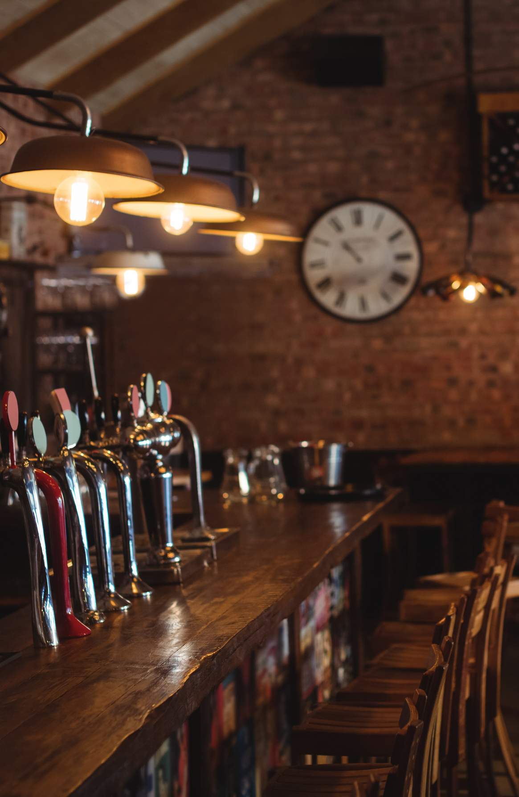


We Are Open
BARS
And
RESTAURANTS
Team Savet

Slide 3
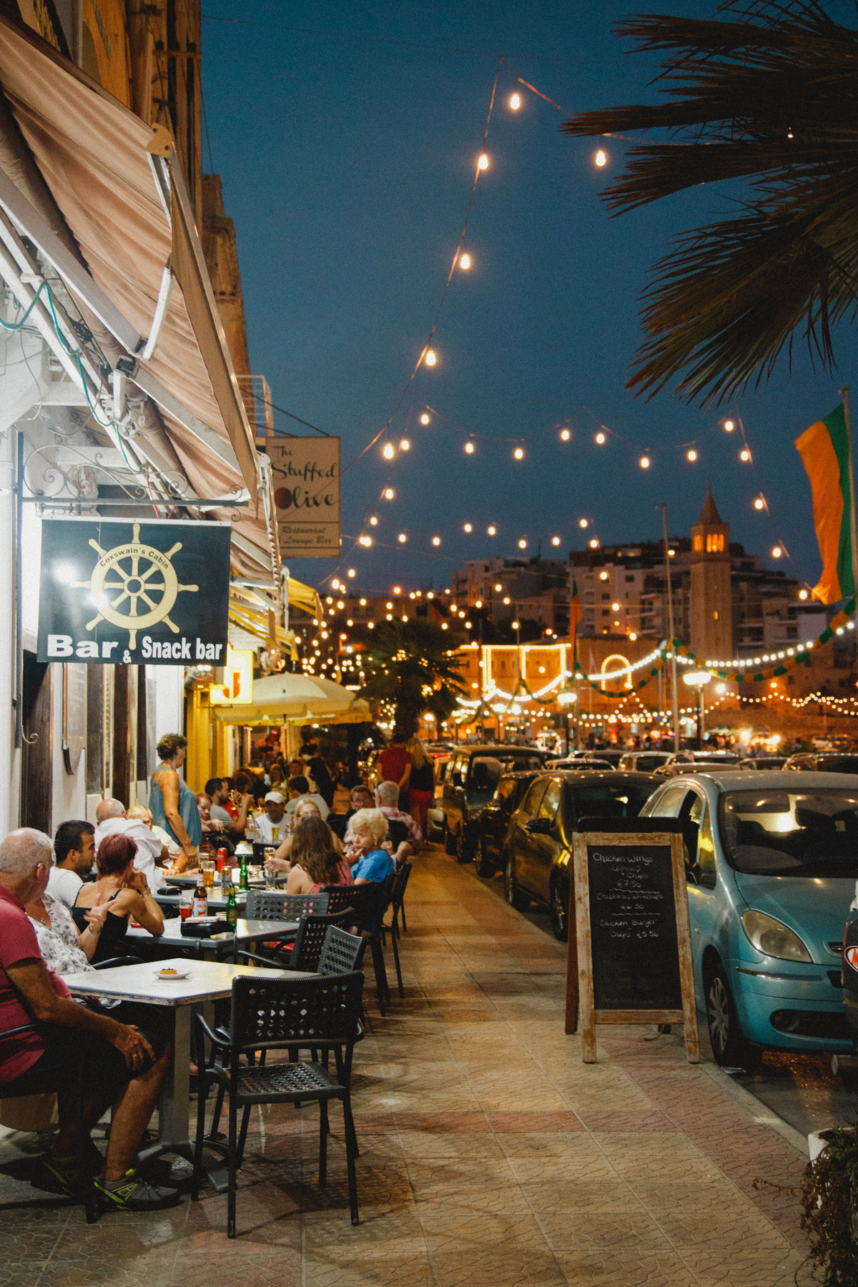

PREATERS
our services ere available every time 24*7
ABOUT US
Pre-order your food and save your precious time. Enjoy our services.
We Are Open

Slide 4
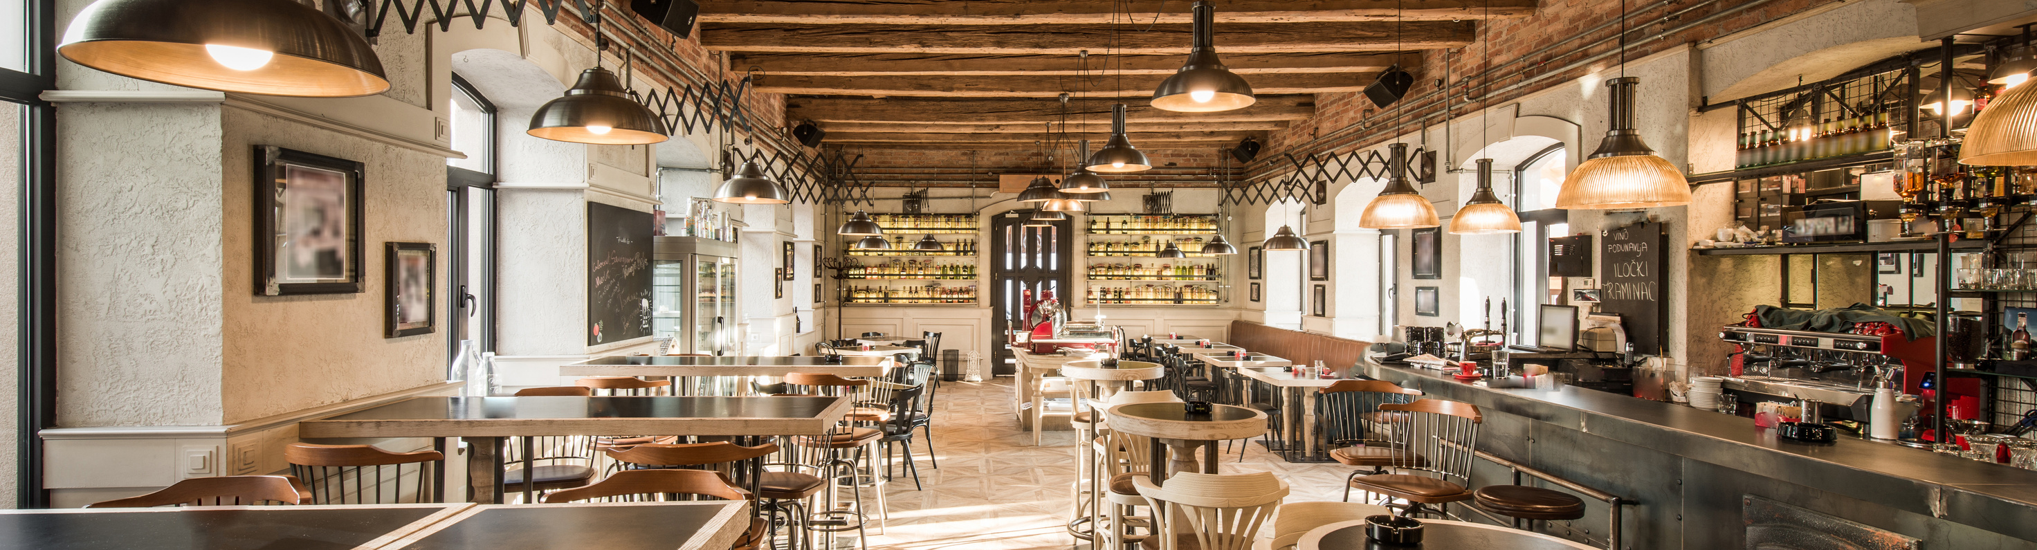
THE SERVICE WE PROVIDE
SERVICE ONE
SERVICE TWO
Teamsavet
You can pre-order and book your seat .
you can also order online and we will deliver your food on time.

Slide 5
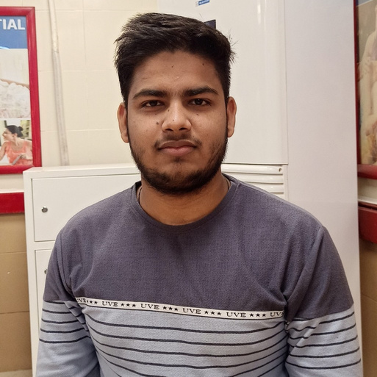
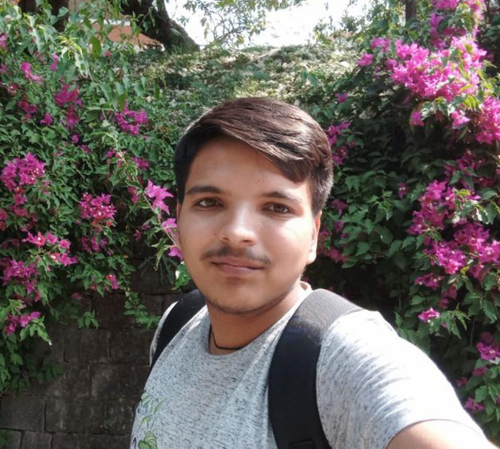
OUR GREAT TEAM
RISHIKESH MISHRA
Bartender
Our team is very experienced and hard working.
AMITABH KUMAR
Waiter

Slide 6
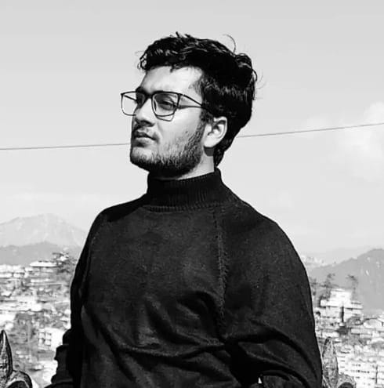
ARYAN MITTAL
Owner
Hello everyone,
Welcome to preaters. we hope you will enjoy our services.
#Teamsavet

Slide 7
TeamSavet
what problems we are trying to
solve?
In recent days, we prefer to deliver food over going to a restaurant. So,what's the main reason behind this?
Have you ever thought🤔🤔🤔........
The main thing is time. How would it be if we enjoy the company of friends and colleagues also the food also comes soon? So, here we are we made this possible now you do not wait for your tasty meal 🍴🍱..You get your meal as you reach the restaurant. Our plan is to make it possible with our startup savet.
April 2022
TeamSavet.com

Slide 8

MAIN
Teamsavet
IDEA
So, Our main idea is to create an application which added local restaurants,bars and cafeteria to customers by an online platform where customare free to choose their favorite restaurant from the list of resturant which are enrolled to us.
April 2022
Teamsavet.com

Slide 9


Teamsavet
Our Values
We embrace all the skills and experience of all our qualified builders and team members to put the best work ahead
and this is what we consider our major aim and objective.
Vision
Mission
There is big gap in market for local wander and seller which provide services at lower cost.So,we made possible by our website which is third party application .
Our mission is to made people's life easy by saving their time.So,no one have to waste their precious time and setup a minimal-price so both customers and dealer benefit.
April 2022
Teamsavet.com

Slide 10
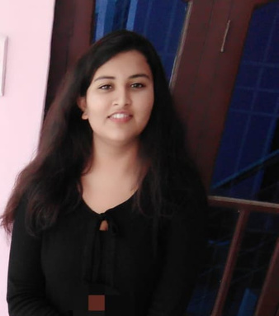
Teamsavet
Our Hard Working Team
Pritika Chaudhary
Amitabh Kumar
Aryan Mittal
Rishikesh Mishra
CEO
Co-founder
Co-founder
Founder
April 2022
Teamsavet.com

Slide 11
Teamsavet
Our Business Aspect
We can make money by following methods:
We add subscription rate for restaurants so we can help in marketing of that restaurant .So,as much as restaurant added more we get profit from this by using digital marketing methods.
We serve customare the fresh and hygenic by pre-ordering thir meal by our application or website.
We create a platform not only for restaurant or food stuffs we expand it to barber shops,merchant shops and other local area market.
We are trying to grow Indian remote market to an online level so it get profit and we also get profit by charging a small amount form there.
April 2022
Teamsavet.com

Slide 12
We Are Open
THANK YOU
10.

